Slide 1

Chromium Component Analysis Project (keyed_service)
BTP600 – Final Project
Khai Phan, Tyrell Unser, Mamadou Diallo

Slide 2
Discussion Question
Which patterns are they using to write the code?
Is there any requirement for other components to access it?
Why did the developer decide to use it?

Slide 3
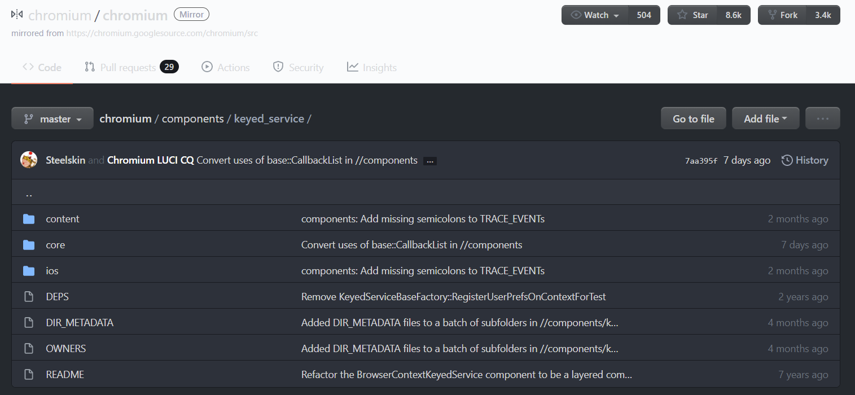
keyed_service

Slide 4
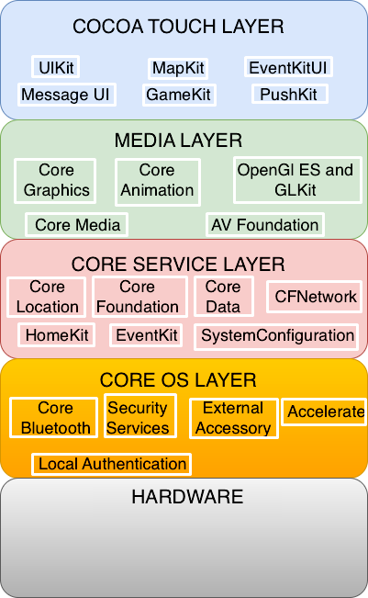
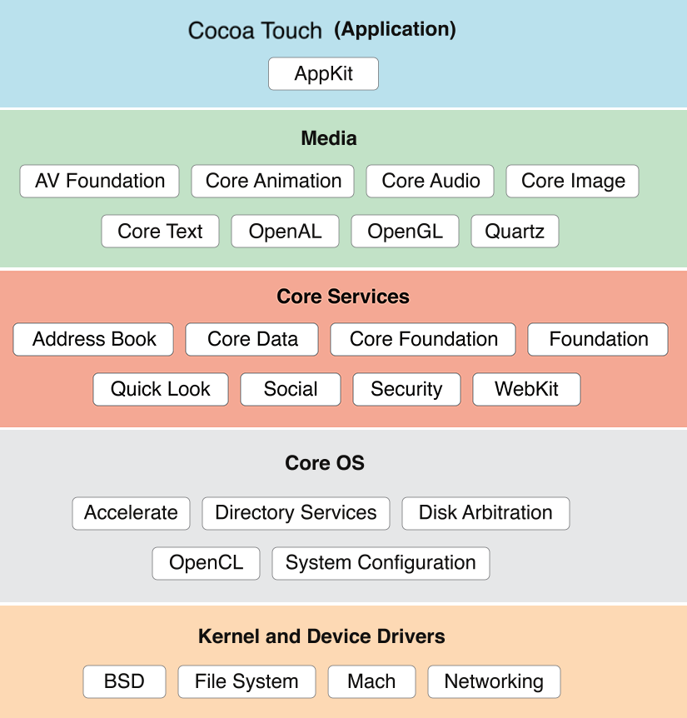
Component Layered?

Slide 5
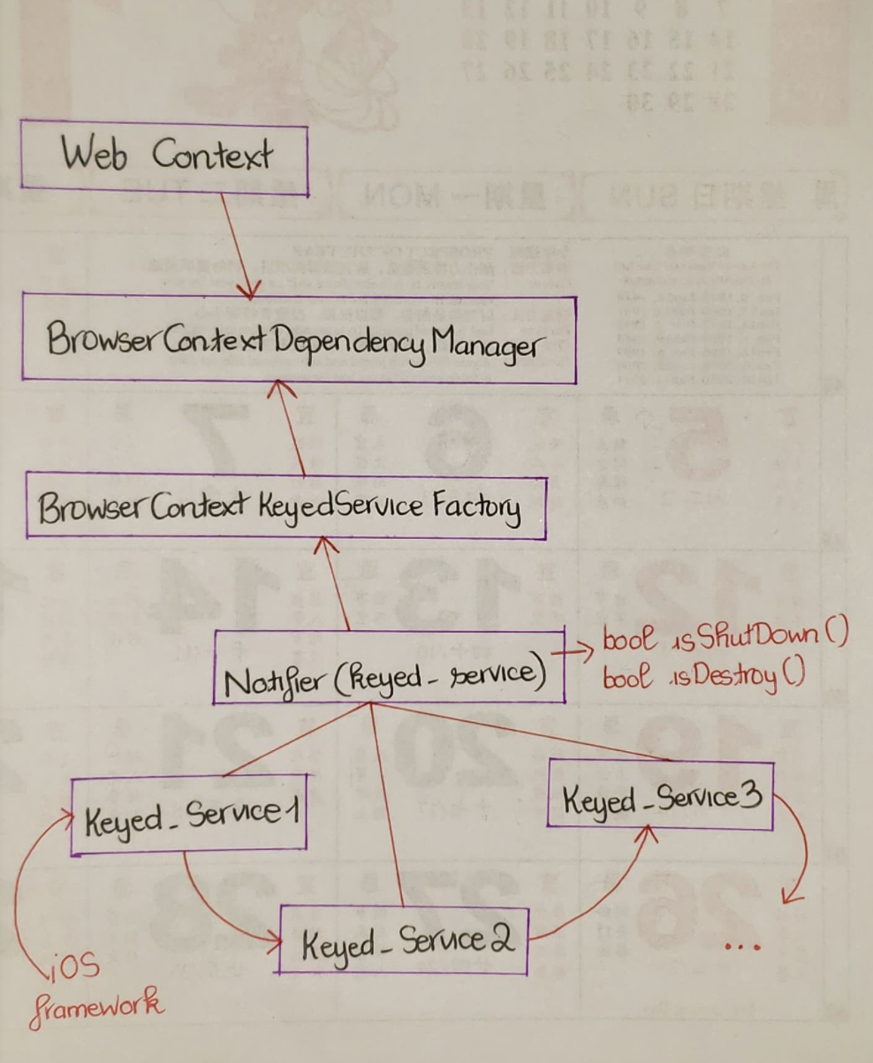

Slide 6
keyed_service

Slide 7
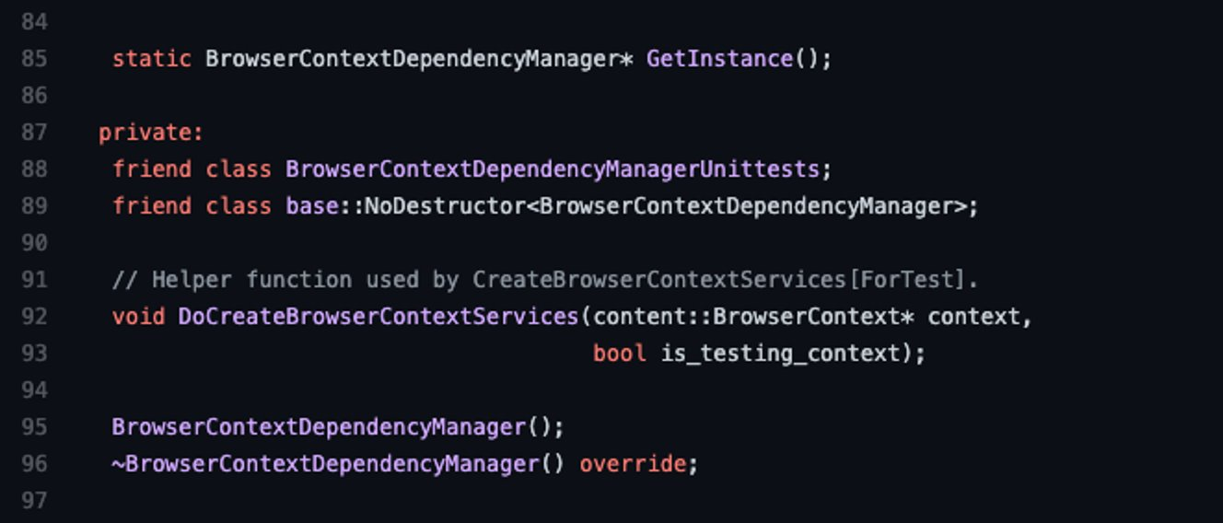
Singleton

Slide 8
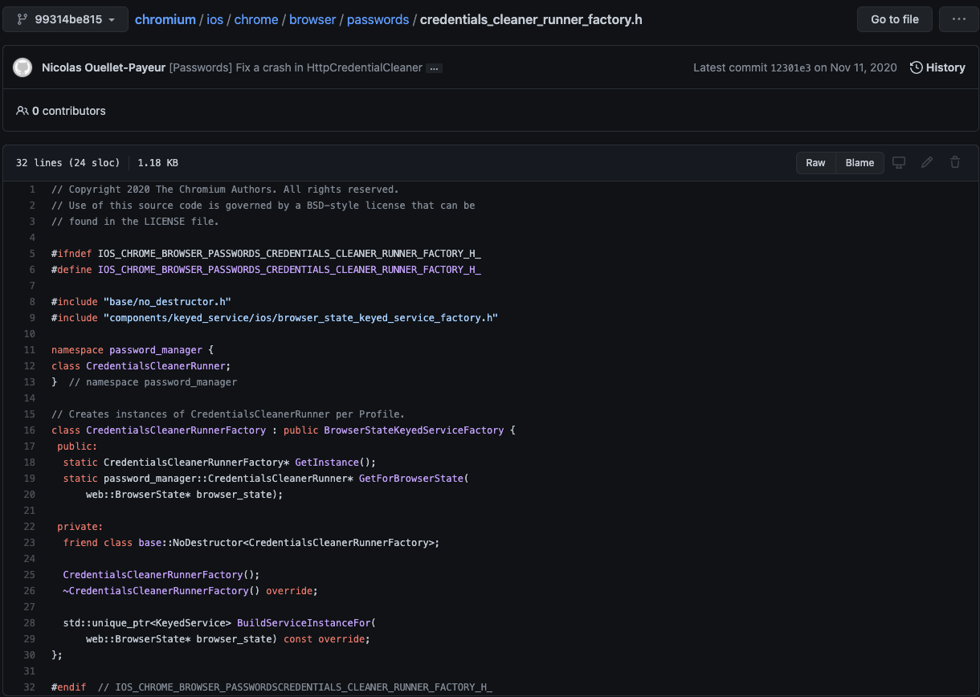
Singleton

Slide 9
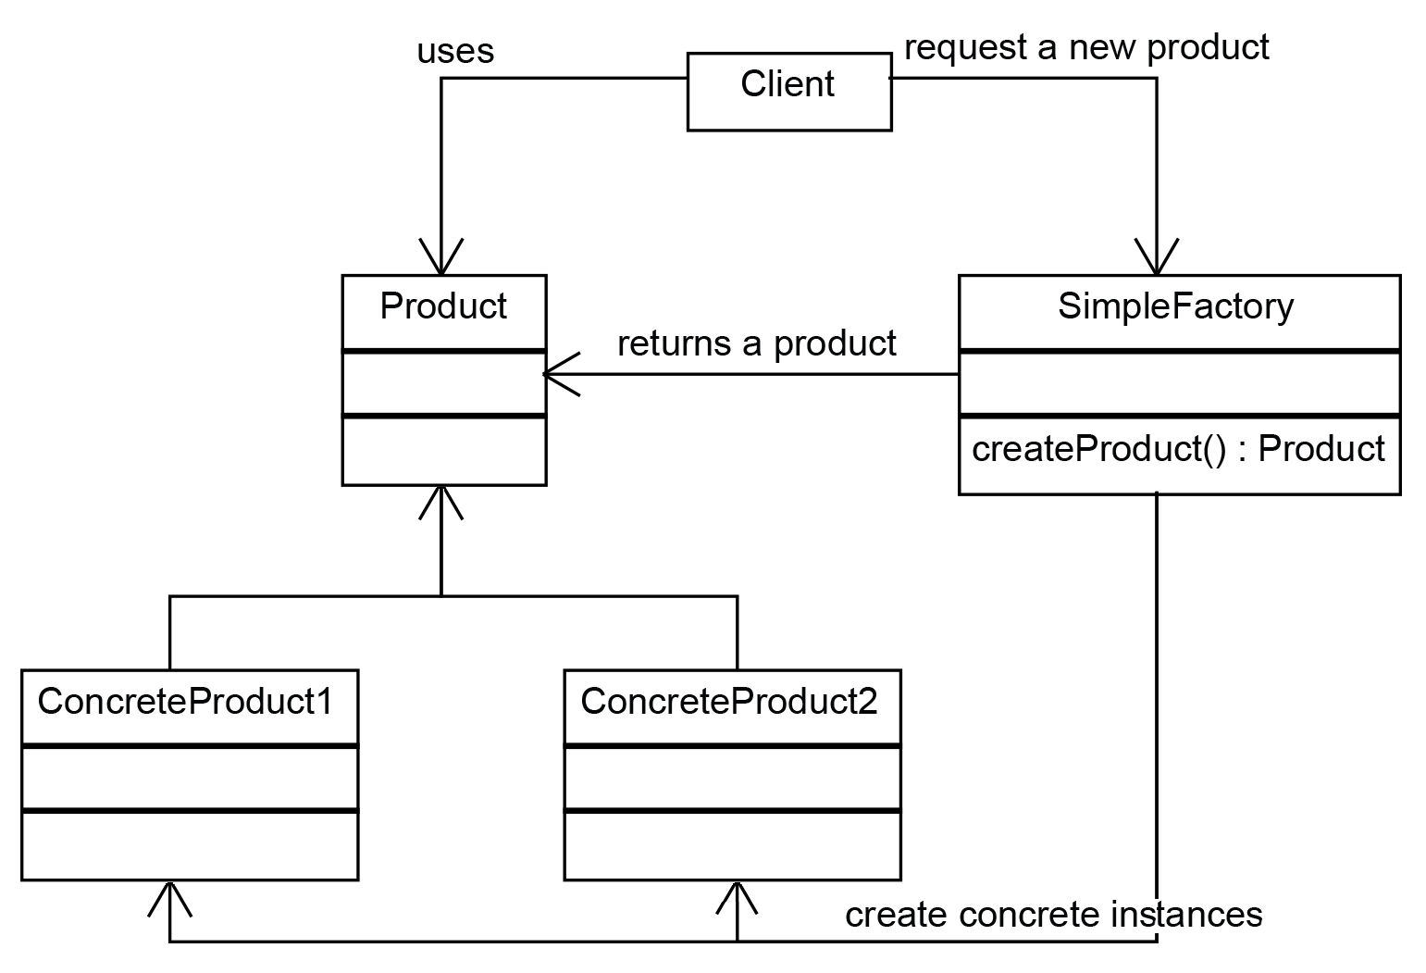
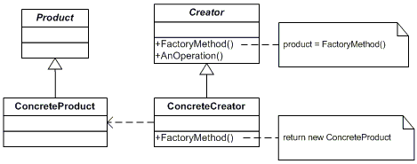
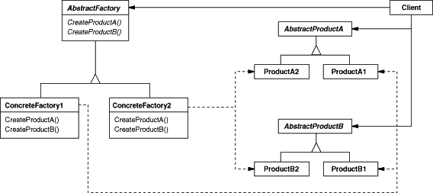
Factory Pattern
Factory
Factory Method
Abstract Factory

Slide 10
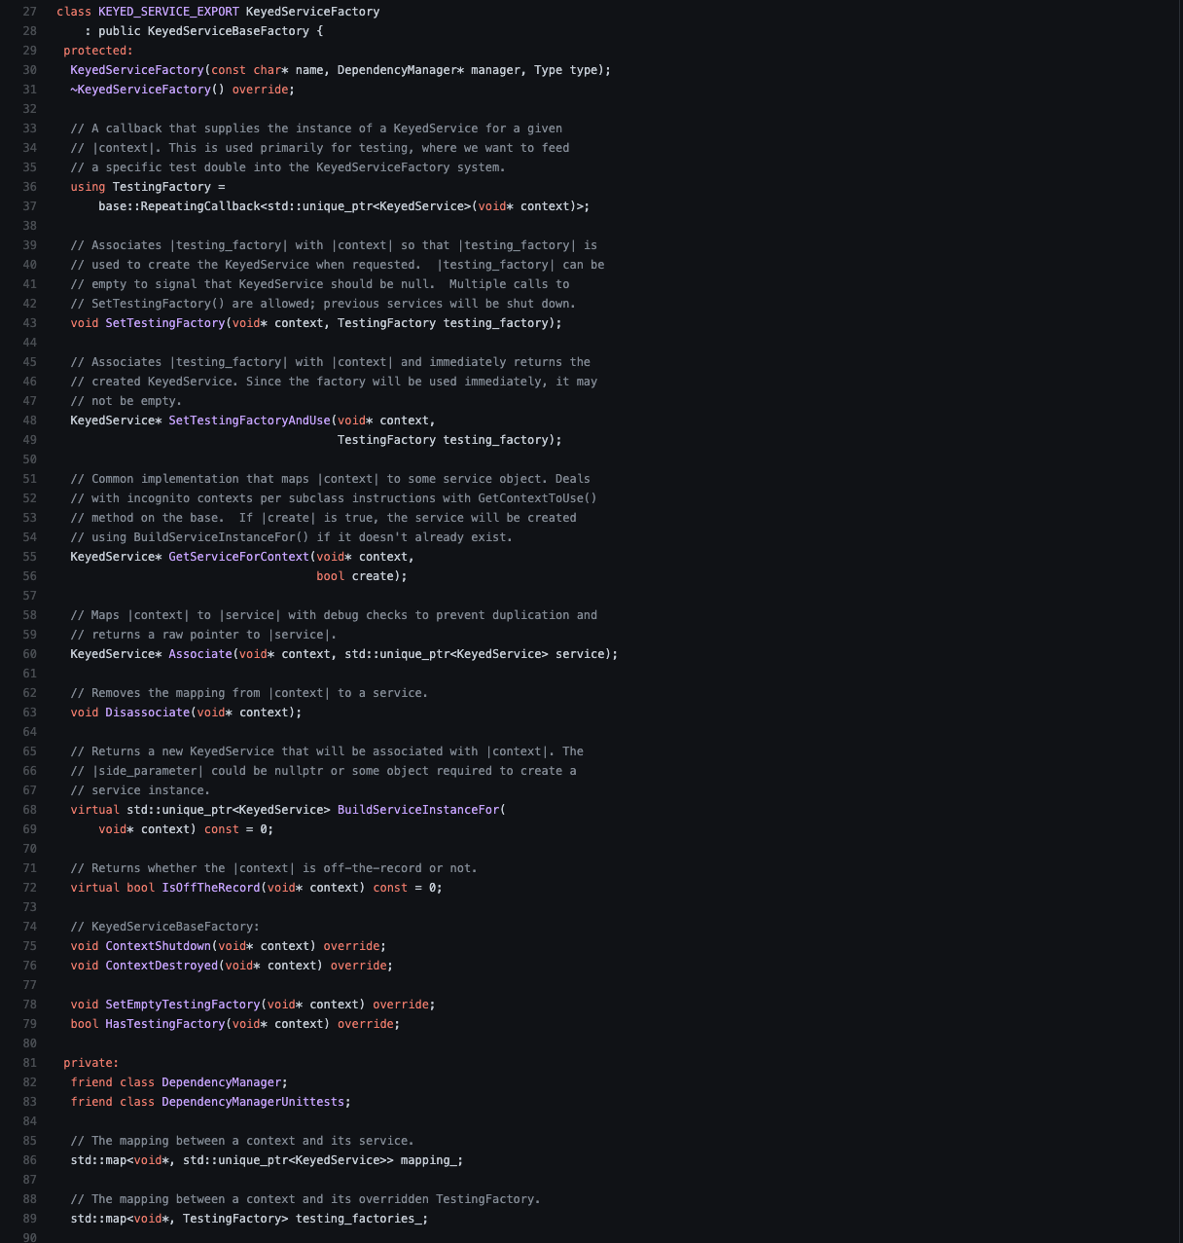
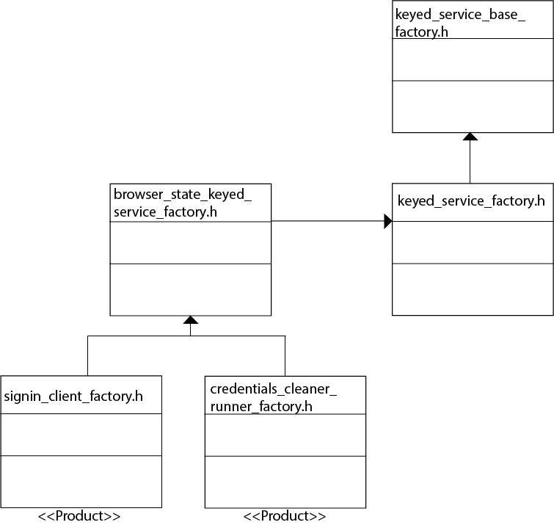
Factory

Slide 11
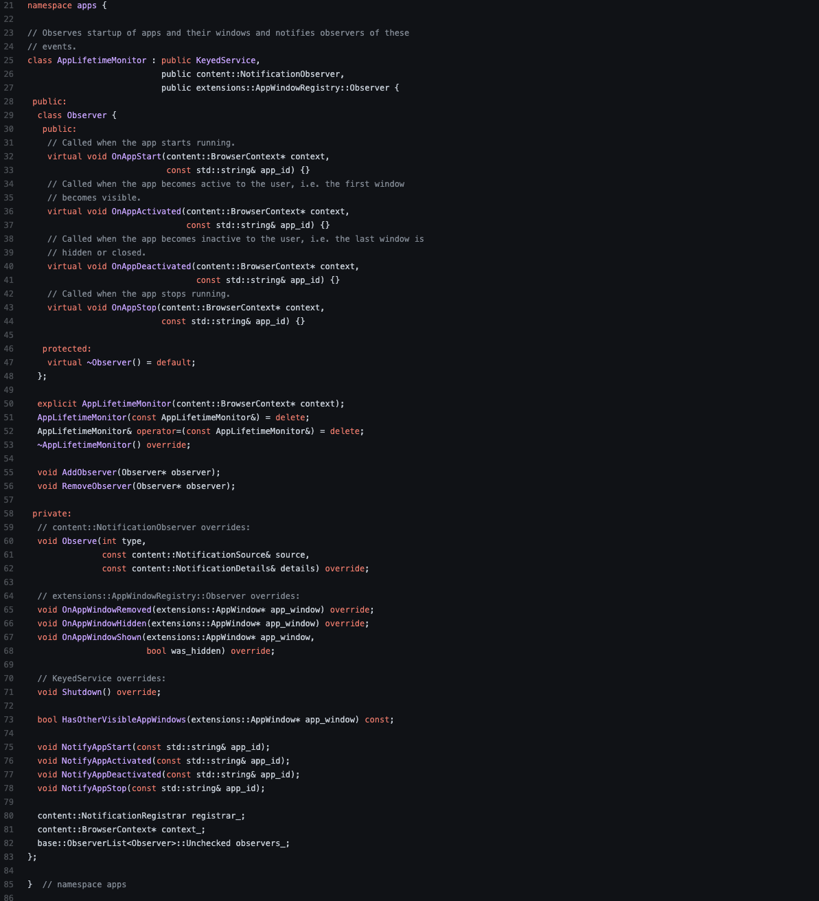
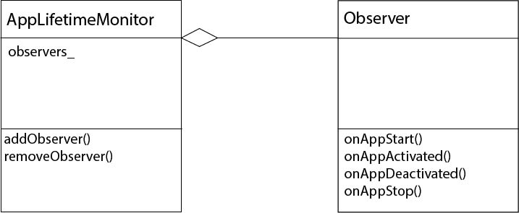
Observer (app_lifetime_monitor.h)

Slide 12

Why ?

Slide 13
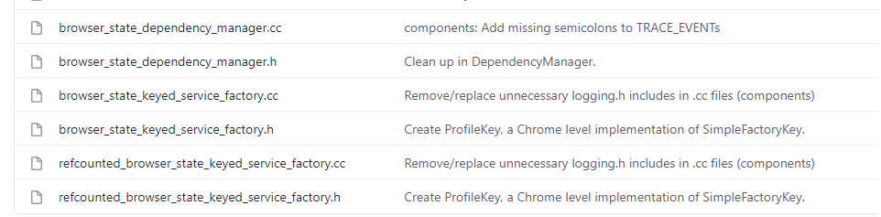
Keyed_Services/iOS

Slide 14
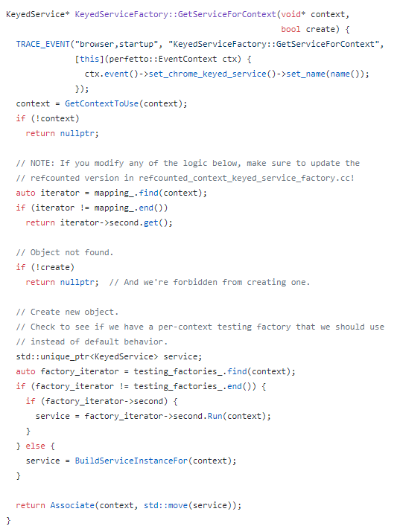

Singleton

Slide 15
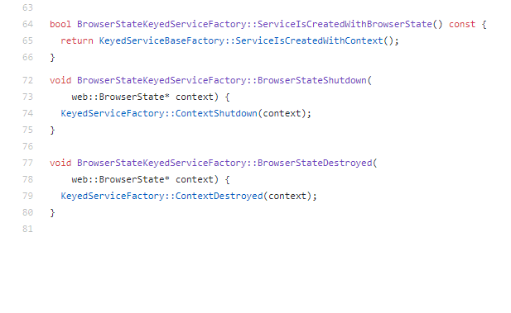
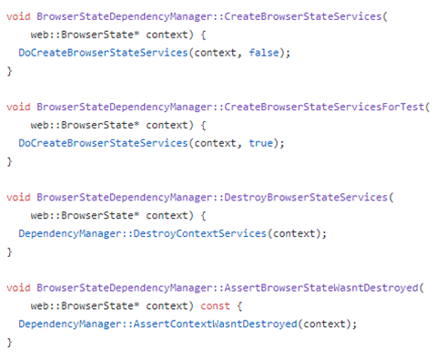
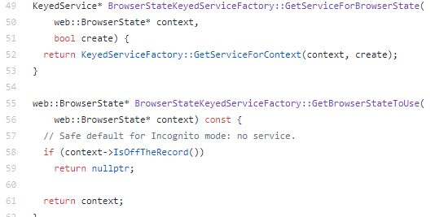
State

Slide 16
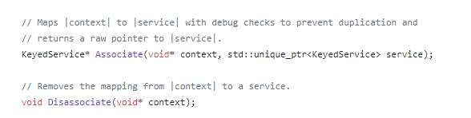
Observer

Slide 17
